Slide 1
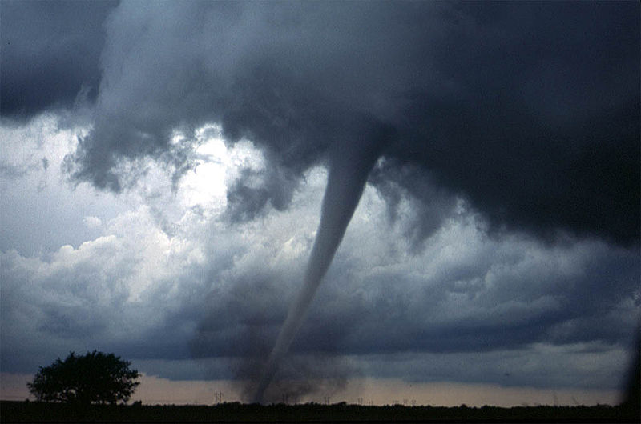
Instructional Objective: After the completion of a class discussion and National Geographic video on Tornadoes, the students will create a Tornado Flip Book and compile a list of facts about tornadoes. The students will write at least three facts about tornadoes on the cover of their Tornado Flipbook. Standard: PS 2.2p Hazardous weather conditions include thunderstorms, tornadoes, hurricanes, ice storms, and blizzards. Humans can prepare for and respond to these conditions if given sufficient warning.
Aim: What are Tornadoes?
Do Now: After watching the following video clip, describe the emotions it depicted.
http://www.cmt.com/videos/little-big-town/852201/tornado.jhtml

Slide 2
Instructional Objective: After the completion of a class discussion and National Geographic video on Tornadoes, the students will create a Tornado Flip Book and compile a list of facts about tornadoes. The students will write at least three facts about tornadoes on the cover of their Tornado Flipbook. Standard: PS 2.2p Hazardous weather conditions include thunderstorms, tornadoes, hurricanes, ice storms, and blizzards. Humans can prepare for and respond to these conditions if given sufficient warning.
Formation of a Tornadoes
A tornadoes is a violently rotating column of air that comes in contact with the ground.
Tornadoes are produced by SEVERE thunderstorms.
In these severe thunderstorms, the different speed and direction of wind creates a rotating column of air parallel to the ground.
Then strong updrafts tilt the column upward creating a FUNNEL CLOUD.
The strong downdrafts of a thunderstorm then pull the funnel cloud toward Earth.

Slide 3
Instructional Objective: After the completion of a class discussion and National Geographic video on Tornadoes, the students will create a Tornado Flip Book and compile a list of facts about tornadoes. The students will write at least three facts about tornadoes on the cover of their Tornado Flipbook. Standard: PS 2.2p Hazardous weather conditions include thunderstorms, tornadoes, hurricanes, ice storms, and blizzards. Humans can prepare for and respond to these conditions if given sufficient warning.
Size and Speed of Torpedoes
Tornadoes can be different sizes in diameter. Normally they do not exceed 200m in diameter.
The wind associated with a tornado can reach up to 800km per hour. This wind speed is due to the dramatic differences in air pressure.
Tornadoes can last a few minutes up to an hour but are normally very short.

Slide 4
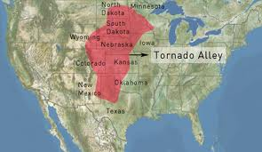
Instructional Objective: After the completion of a class discussion and National Geographic video on Tornadoes, the students will create a Tornado Flip Book and compile a list of facts about tornadoes. The students will write at least three facts about tornadoes on the cover of their Tornado Flipbook. Standard: PS 2.2p Hazardous weather conditions include thunderstorms, tornadoes, hurricanes, ice storms, and blizzards. Humans can prepare for and respond to these conditions if given sufficient warning.
“Tornado Alley”
In the central plains of the United States and the Mississippi River Valley, the warm moist air from the Gulf of Mexico collides with the cold air from the Rocky Mountains.
In this collision, the cold air pushes on top of the warm air, and then pushes down forcing the warm air to rise.
This creates a vacuum effect and causes many tornadoes throughout the year, earning the name Tornado Alley.

Slide 5
Instructional Objective: After the completion of a class discussion and National Geographic video on Tornadoes, the students will create a Tornado Flip Book and compile a list of facts about tornadoes. The students will write at least three facts about tornadoes on the cover of their Tornado Flipbook. Standard: PS 2.2p Hazardous weather conditions include thunderstorms, tornadoes, hurricanes, ice storms, and blizzards. Humans can prepare for and respond to these conditions if given sufficient warning.
Damages
Tornadoes although very short storms, are the most violent storms.
The winds associated with tornadoes will rip buildings apart and can lift up animals, trees, cars, and other objects and throw them for miles.
Let’s watch the following video on tornadoes:
http://video.nationalgeographic.com/video/kids/forces-of-nature-kids/tornadoes-101-kids/

Slide 6
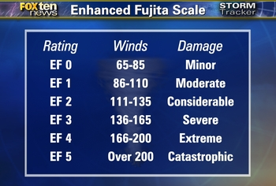
Instructional Objective: After the completion of a class discussion and National Geographic video on Tornadoes, the students will create a Tornado Flip Book and compile a list of facts about tornadoes. The students will write at least three facts about tornadoes on the cover of their Tornado Flipbook. Standard: PS 2.2p Hazardous weather conditions include thunderstorms, tornadoes, hurricanes, ice storms, and blizzards. Humans can prepare for and respond to these conditions if given sufficient warning.

Slide 7
Instructional Objective: After the completion of a class discussion and National Geographic video on Tornadoes, the students will create a Tornado Flip Book and compile a list of facts about tornadoes. The students will write at least three facts about tornadoes on the cover of their Tornado Flipbook. Standard: PS 2.2p Hazardous weather conditions include thunderstorms, tornadoes, hurricanes, ice storms, and blizzards. Humans can prepare for and respond to these conditions if given sufficient warning.
Now…
Let’s create our own tornadoes!!!!!
We are going to make tornado flip books.
First, you will each receive two sheets of the flip book pages.
You will cut out all the different squares and stack them 1-1 to 16-16.
Next we will staple it together.
On the cover list at least 3 facts about tornadoes!
Finally, watch your tornado go!

Slide 8
Instructional Objective: After the completion of a class discussion and National Geographic video on Tornadoes, the students will create a Tornado Flip Book and compile a list of facts about tornadoes. The students will write at least three facts about tornadoes on the cover of their Tornado Flipbook. Standard: PS 2.2p Hazardous weather conditions include thunderstorms, tornadoes, hurricanes, ice storms, and blizzards. Humans can prepare for and respond to these conditions if given sufficient warning.
Homework:
Complete worksheet on
“Tornado Alley”

