Slide 1
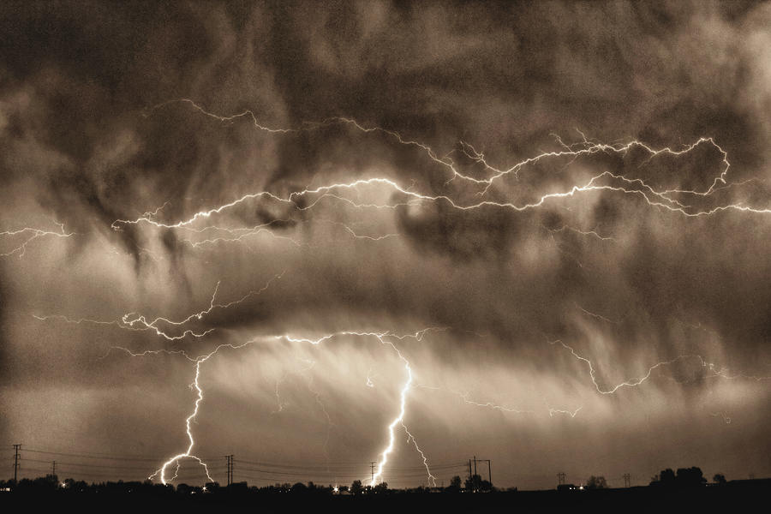

Instructional Objective: After the completion of a class discussion on thunderstorms, the students will be able to list facts that they learned about thunderstorms in the “What I Learned” section of a KWL chart. The students will be able to list at least two facts about thunderstorms that they learned during the lesson.
Standard: PS 2.2p Hazardous weather conditions include thunderstorms, tornadoes, hurricanes, ice storms, and blizzards. Humans can prepare for and respond to these conditions if given sufficient warning.
Aim: What are thunderstorms?
Do Now: Please take a seat, take out a notebook and pen, and prepare to hear a story.

Slide 2
Instructional Objective: After the completion of a class discussion on thunderstorms, the students will be able to list facts that they learned about thunderstorms in the “What I Learned” section of a KWL chart. The students will be able to list at least two facts about thunderstorms that they learned during the lesson.
Standard: PS 2.2p Hazardous weather conditions include thunderstorms, tornadoes, hurricanes, ice storms, and blizzards. Humans can prepare for and respond to these conditions if given sufficient warning.
Tell Me What You…
Saw | Heard | Tasted | Smelled | Felt

Slide 3
Instructional Objective: After the completion of a class discussion on thunderstorms, the students will be able to list facts that they learned about thunderstorms in the “What I Learned” section of a KWL chart. The students will be able to list at least two facts about thunderstorms that they learned during the lesson.
Standard: PS 2.2p Hazardous weather conditions include thunderstorms, tornadoes, hurricanes, ice storms, and blizzards. Humans can prepare for and respond to these conditions if given sufficient warning.
Now…
I’m going to come around with Post-Its.
Each of you will get a stack of them.
Write what you already know about thunderstorms on a few of them and then what you what to know about thunderstorms on a few others.
Place your Post-Its where they belong on the KWL chart on the board.
Let’s discuss THUNDERSTORMS!!!

Slide 4
Instructional Objective: After the completion of a class discussion on thunderstorms, the students will be able to list facts that they learned about thunderstorms in the “What I Learned” section of a KWL chart. The students will be able to list at least two facts about thunderstorms that they learned during the lesson.
Standard: PS 2.2p Hazardous weather conditions include thunderstorms, tornadoes, hurricanes, ice storms, and blizzards. Humans can prepare for and respond to these conditions if given sufficient warning.
What is a Thunderstorm?
A thunderstorm is a storm with heavy rain, lightning, thunder roars and possibly hail.
They occur along cold fronts and in masses of warm, moist air. In these conditions, the warm, moist air is forced upward where it condenses and forms large CUMULONIMBUS clouds.
As the air condenses, it begins to cool and sinks back down to Earth’s surface.
This quick rising and sinking of air forms strong winds called updrafts which hold water droplets and ice pellets in the cloud, allowing them to grow large.
They mainly happen during the summer months.
They are the most common form of severe weather.

Slide 5

Instructional Objective: After the completion of a class discussion on thunderstorms, the students will be able to list facts that they learned about thunderstorms in the “What I Learned” section of a KWL chart. The students will be able to list at least two facts about thunderstorms that they learned during the lesson.
Standard: PS 2.2p Hazardous weather conditions include thunderstorms, tornadoes, hurricanes, ice storms, and blizzards. Humans can prepare for and respond to these conditions if given sufficient warning.
What is Lightning?
The rapid rising and sinking molecules inside the cloud rub together, creating static electricity.
The release of this energy is LIGHTNING.
Lightning is caused by the flow of currents between the oppositely charged molecules in the cloud.
Lightning can occur within a cloud, between separate clouds, or between the cloud and the ground.

Slide 6
Instructional Objective: After the completion of a class discussion on thunderstorms, the students will be able to list facts that they learned about thunderstorms in the “What I Learned” section of a KWL chart. The students will be able to list at least two facts about thunderstorms that they learned during the lesson.
Standard: PS 2.2p Hazardous weather conditions include thunderstorms, tornadoes, hurricanes, ice storms, and blizzards. Humans can prepare for and respond to these conditions if given sufficient warning.
What is Thunder?
As lightning occurs, it heats the surrounding air rapidly.
The air surrounding lightning can reach 30,000^{O}F, which is 5x the temperature of the sun’s surface!
This drastic change in temperature causes the air to rapidly expand and contract, which produces sound waves known as thunder.

Slide 7
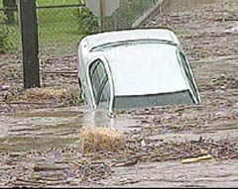
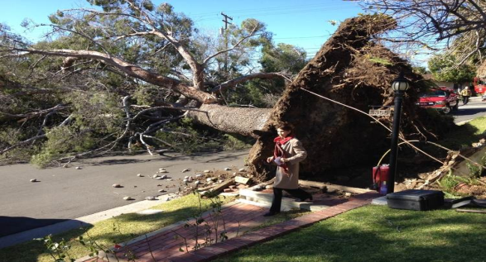
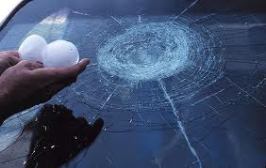
Instructional Objective: After the completion of a class discussion on thunderstorms, the students will be able to list facts that they learned about thunderstorms in the “What I Learned” section of a KWL chart. The students will be able to list at least two facts about thunderstorms that they learned during the lesson.
Standard: PS 2.2p Hazardous weather conditions include thunderstorms, tornadoes, hurricanes, ice storms, and blizzards. Humans can prepare for and respond to these conditions if given sufficient warning.
Why are Thunderstorms
Severe Weather?
If the storm stays in an area and provides prolonged heavy rain, then FLASH FLOODS can occur.
Winds can reach up to 89 mph, blowing down trees, power lines, and other things.
Hail is formed by thunderstorms, which can damage cars, houses and destroy crops.

Slide 8
Instructional Objective: After the completion of a class discussion on thunderstorms, the students will be able to list facts that they learned about thunderstorms in the “What I Learned” section of a KWL chart. The students will be able to list at least two facts about thunderstorms that they learned during the lesson.
Standard: PS 2.2p Hazardous weather conditions include thunderstorms, tornadoes, hurricanes, ice storms, and blizzards. Humans can prepare for and respond to these conditions if given sufficient warning.
What did you learn?!
Now that we have completed our lesson on thunderstorms…tell me what you’ve learned!
Use the remaining Post-Its on your desk to write down AT LEAST TWO (2) things you learned about thunderstorms!

Slide 9
Instructional Objective: After the completion of a class discussion on thunderstorms, the students will be able to list facts that they learned about thunderstorms in the “What I Learned” section of a KWL chart. The students will be able to list at least two facts about thunderstorms that they learned during the lesson.
Standard: PS 2.2p Hazardous weather conditions include thunderstorms, tornadoes, hurricanes, ice storms, and blizzards. Humans can prepare for and respond to these conditions if given sufficient warning.
HOMEWORK:
Complete the worksheet on thunderstorms.

