Slide 1
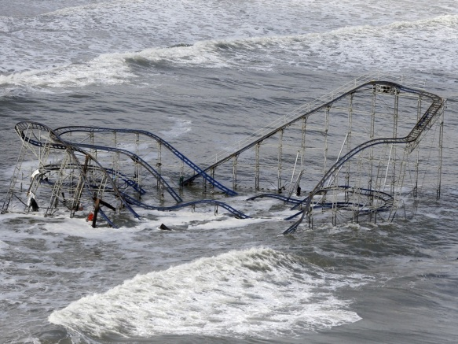
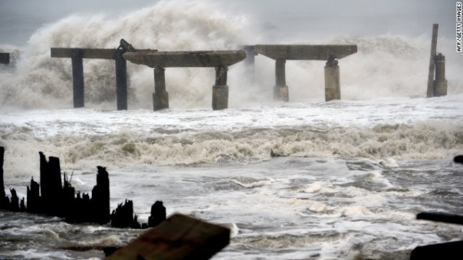
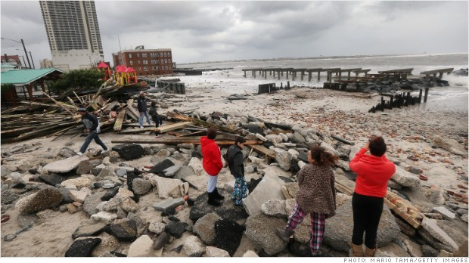
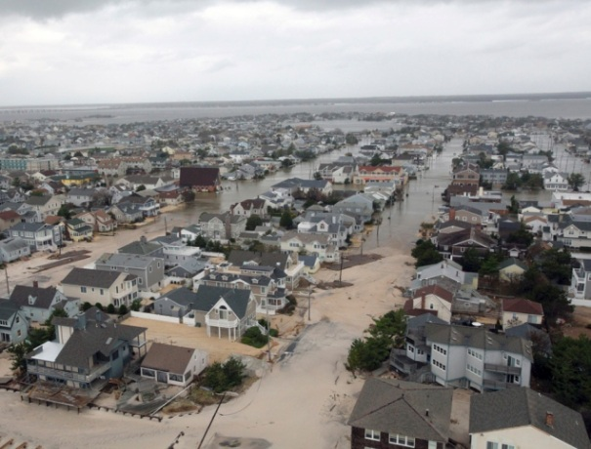
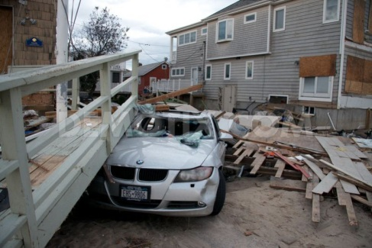
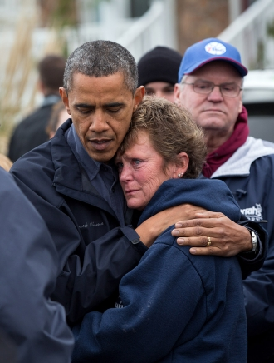
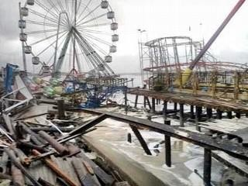
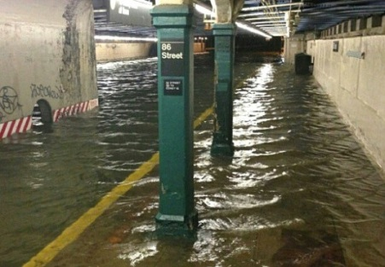
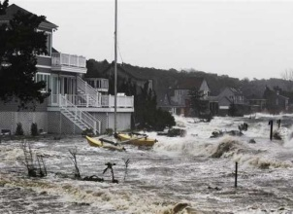
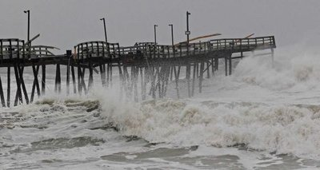
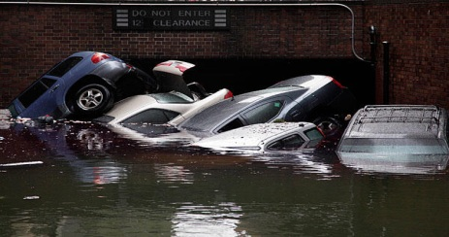
Instructional Objection: After the completion of a class discussion on hurricanes and blizzards, the students will build a perfect hurricane on create-a-cane.com while recording this information in a four-tab hot dog foldable. The students will score at least an 80 on the game website for creating a perfect category 5 hurricane. Standard: PS 2.2p Hazardous weather conditions include thunderstorms, tornadoes, hurricanes, ice storms, and blizzards. Humans can prepare for and respond to these conditions if given sufficient warning.
Aim: What forms a Hurricane?
Do Now: Listen to the song and look at the pictures below. After the song is completed write down the emotions that you felt and what you were doing during Hurricane Sandy.

Slide 2
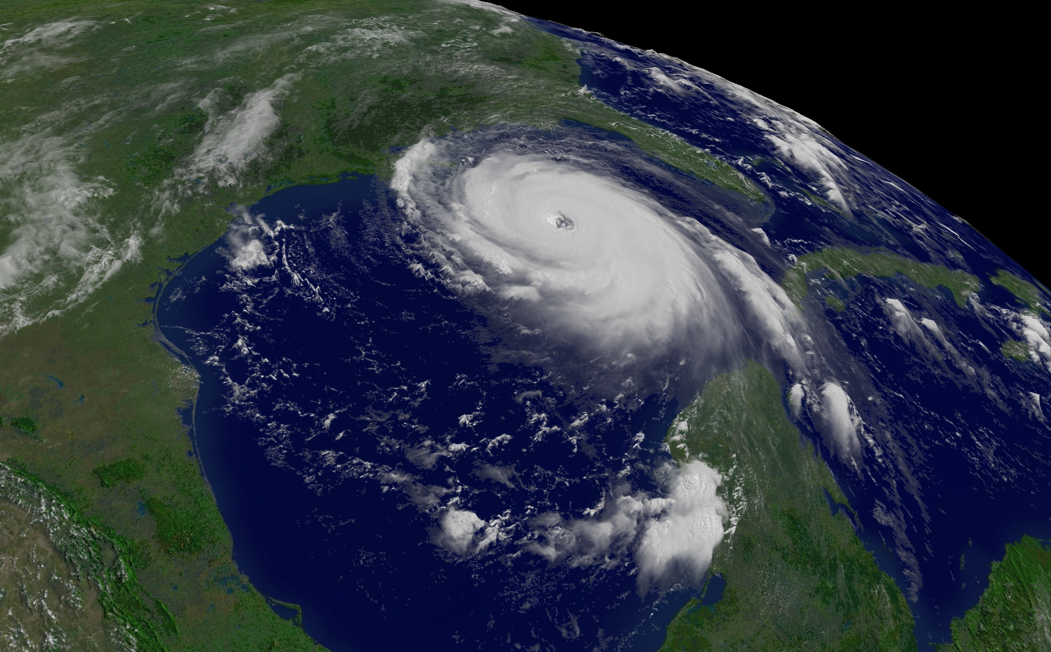
Instructional Objection: After the completion of a class discussion on hurricanes and blizzards, the students will build a perfect hurricane on create-a-cane.com while recording this information in a four-tab hot dog foldable. The students will score at least an 80 on the game website for creating a perfect category 5 hurricane. Standard: PS 2.2p Hazardous weather conditions include thunderstorms, tornadoes, hurricanes, ice storms, and blizzards. Humans can prepare for and respond to these conditions if given sufficient warning.
What are Hurricanes?
One of the most powerful types of storms are hurricanes.
Hurricanes are large, swirling, low pressure systems that form over the ocean.
It is similar to low pressure systems that form over land but are much stronger.
These storms start to form in the ocean around the equator. In the Northern Hemisphere winds start to turn counter-clockwise.
The strongest storms that affect North America start off the coast of Western Africa.
Hurricanes mainly occur from June to November in North America.

Slide 3
Instructional Objection: After the completion of a class discussion on hurricanes and blizzards, the students will build a perfect hurricane on create-a-cane.com while recording this information in a four-tab hot dog foldable. The students will score at least an 80 on the game website for creating a perfect category 5 hurricane. Standard: PS 2.2p Hazardous weather conditions include thunderstorms, tornadoes, hurricanes, ice storms, and blizzards. Humans can prepare for and respond to these conditions if given sufficient warning.
How do Hurricanes Form?
As the water is heated, it evaporates and creates warm/moist air mass.
As air condenses it cools, creating convection current of warm and cool air.
Like a machine the heat energy from the ocean changes into wind.
The storms grow stronger the longer they are over their energy source, or the warm, moist ocean water.
The center is called the eye.

Slide 4
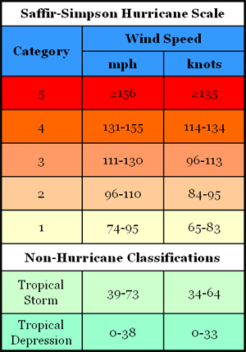
Instructional Objection: After the completion of a class discussion on hurricanes and blizzards, the students will build a perfect hurricane on create-a-cane.com while recording this information in a four-tab hot dog foldable. The students will score at least an 80 on the game website for creating a perfect category 5 hurricane. Standard: PS 2.2p Hazardous weather conditions include thunderstorms, tornadoes, hurricanes, ice storms, and blizzards. Humans can prepare for and respond to these conditions if given sufficient warning.
How are Hurricanes Classified?
Hurricanes
are also
known as
Typhoons and
Cyclones.

Slide 5
Instructional Objection: After the completion of a class discussion on hurricanes and blizzards, the students will build a perfect hurricane on create-a-cane.com while recording this information in a four-tab hot dog foldable. The students will score at least an 80 on the game website for creating a perfect category 5 hurricane. Standard: PS 2.2p Hazardous weather conditions include thunderstorms, tornadoes, hurricanes, ice storms, and blizzards. Humans can prepare for and respond to these conditions if given sufficient warning.
What happened when a Hurricane reaches land?
Hurricanes are the most destructive when they first hit land since once the hurricanes goes over land, its power source is cut off and the storm begins to lose strength.
When they hit land the high winds associated with hurricanes can form heavy rain, tornadoes, and storm surges. This can cause a lot of damage.
Hurricanes can destroy crops, demolish buildings, kill people and other animals.

Slide 6
Instructional Objection: After the completion of a class discussion on hurricanes and blizzards, the students will build a perfect hurricane on create-a-cane.com while recording this information in a four-tab hot dog foldable. The students will score at least an 80 on the game website for creating a perfect category 5 hurricane. Standard: PS 2.2p Hazardous weather conditions include thunderstorms, tornadoes, hurricanes, ice storms, and blizzards. Humans can prepare for and respond to these conditions if given sufficient warning.
What about Blizzards?
Blizzards are storm systems that are similar to hurricanes.
The difference is they occur over winter with wind and heavy snow.
When the wind reaches 56 kmph or more, the visibility drops, and it lasts for more than 3 hours, it is classified as a blizzard.
Blizzards winds are lesser than Hurricane winds since there is less warm moist air to give the storm the same amount of energy.

Slide 7
Instructional Objection: After the completion of a class discussion on hurricanes and blizzards, the students will build a perfect hurricane on create-a-cane.com while recording this information in a four-tab hot dog foldable. The students will score at least an 80 on the game website for creating a perfect category 5 hurricane. Standard: PS 2.2p Hazardous weather conditions include thunderstorms, tornadoes, hurricanes, ice storms, and blizzards. Humans can prepare for and respond to these conditions if given sufficient warning.
Now…
Let’s build a
Category 5 Hurricane!
http://www.nhc.noaa.gov/outreach/games/canelab.htm

Slide 8
Instructional Objection: After the completion of a class discussion on hurricanes and blizzards, the students will build a perfect hurricane on create-a-cane.com while recording this information in a four-tab hot dog foldable. The students will score at least an 80 on the game website for creating a perfect category 5 hurricane. Standard: PS 2.2p Hazardous weather conditions include thunderstorms, tornadoes, hurricanes, ice storms, and blizzards. Humans can prepare for and respond to these conditions if given sufficient warning.
Homework:
Complete the chart marking off the different characteristics associated with different types of severe weather.

