Slide 1
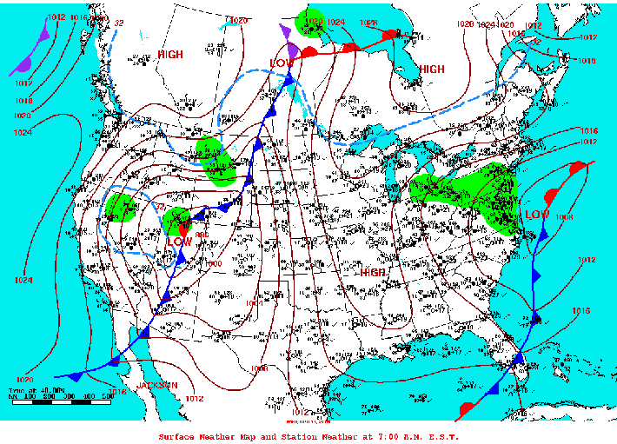
Instructional Objective: After the completion of a jig-saw activity identifying the different characteristics and symbols on a weather map, the students will be able to present their weather map’s forecast and make predictions for tomorrow’s weather in a region of the United States. The students will complete the task with at least seventy-five percent accuracy. Standard: PS 2.2i Weather describes the conditions of the atmosphere at a given location for a short period of time.
Aim: How can we Predict Weather?
Do Now: Watch the Weather Forecast.
http://www.weather.com/video/storm-watch-365

Slide 2
Instructional Objective: After the completion of a jig-saw activity identifying the different characteristics and symbols on a weather map, the students will be able to present their weather map’s forecast and make predictions for tomorrow’s weather in a region of the United States. The students will complete the task with at least seventy-five percent accuracy. Standard: PS 2.2i Weather describes the conditions of the atmosphere at a given location for a short period of time.
Who Predicts the Weather?
A Meteorologist-
a person who studies the weather
How do they Predict the Weather?
Through the use of instruments and with the knowledge of current weather.
Being a Meteorologist is important because they try to keep people informed and prepared to face severe weather since it can be dangerous.
However, since weather changes so rapidly, their predictions are not always right.

Slide 3
Instructional Objective: After the completion of a jig-saw activity identifying the different characteristics and symbols on a weather map, the students will be able to present their weather map’s forecast and make predictions for tomorrow’s weather in a region of the United States. The students will complete the task with at least seventy-five percent accuracy. Standard: PS 2.2i Weather describes the conditions of the atmosphere at a given location for a short period of time.
Where do they get the Data?
The National Weather Service depends on two sources for its information:
- The data collected from the upper atmosphere.
-The data collected from Earth’s surface
The instruments they use help to measure:
- Temperature with the use of a thermometer
- Air Pressure with the use of a barometer
- Winds
- Humidity
- Precipitation (Rain, Snow, Sleet, Hail)
Other ways to collect data are from:
- Computers
- Weather Satellites
- Doppler Radar
- Weather Balloons
All these instruments gather the information to make weather maps used in forecasts.

Slide 4
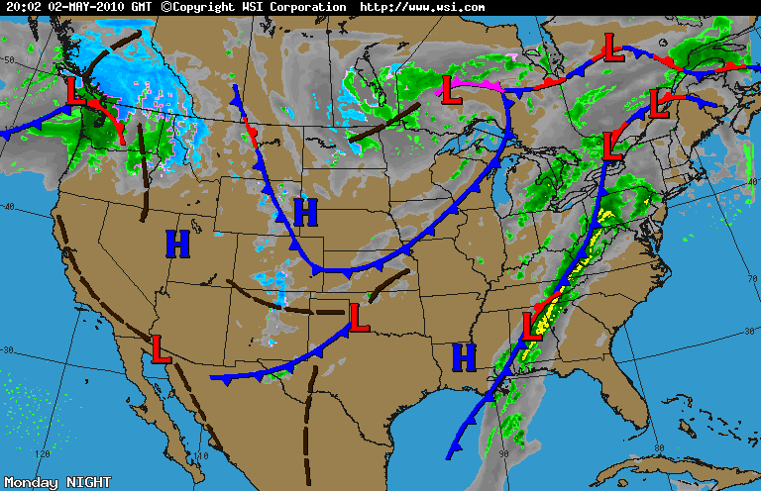
Instructional Objective: After the completion of a jig-saw activity identifying the different characteristics and symbols on a weather map, the students will be able to present their weather map’s forecast and make predictions for tomorrow’s weather in a region of the United States. The students will complete the task with at least seventy-five percent accuracy. Standard: PS 2.2i Weather describes the conditions of the atmosphere at a given location for a short period of time.
Now Let’s Explore the Different Elements on a Weather Map…

Slide 5
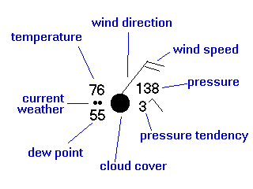
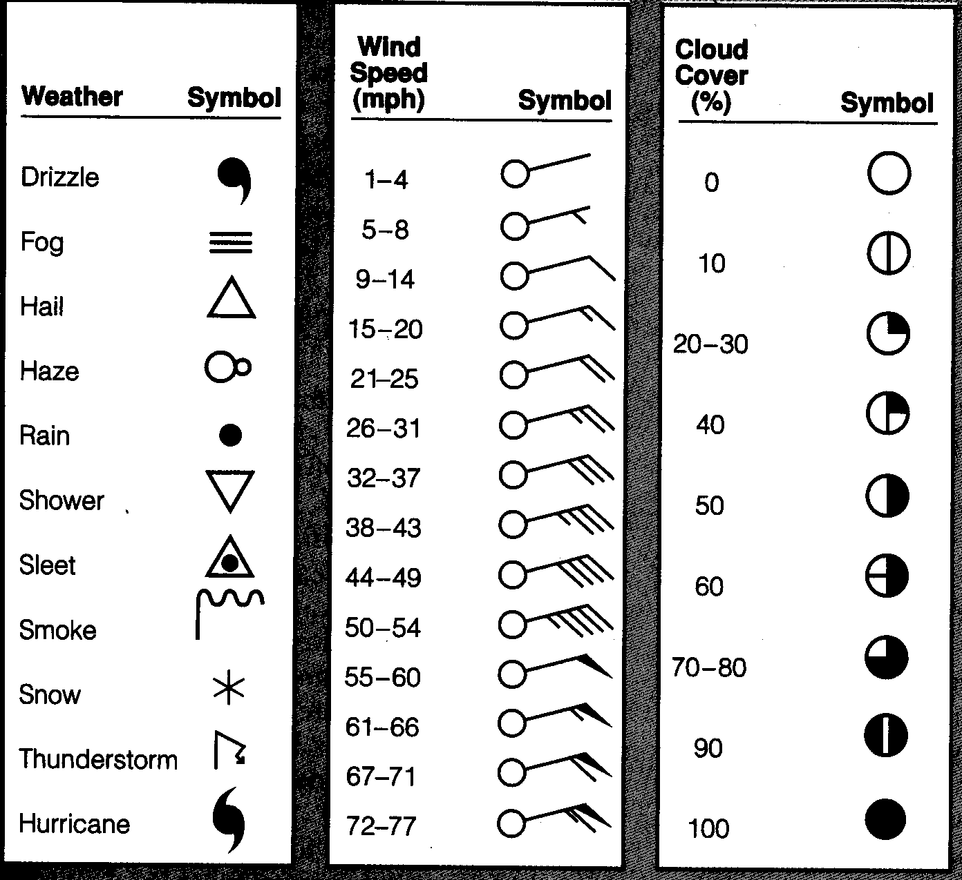
Instructional Objective: After the completion of a jig-saw activity identifying the different characteristics and symbols on a weather map, the students will be able to present their weather map’s forecast and make predictions for tomorrow’s weather in a region of the United States. The students will complete the task with at least seventy-five percent accuracy. Standard: PS 2.2i Weather describes the conditions of the atmosphere at a given location for a short period of time.
Station Models
A Combination of Symbols displayed on a Weather Map Representing the Collected Data for a Specific Location on Earth’s
Surface.

Slide 6
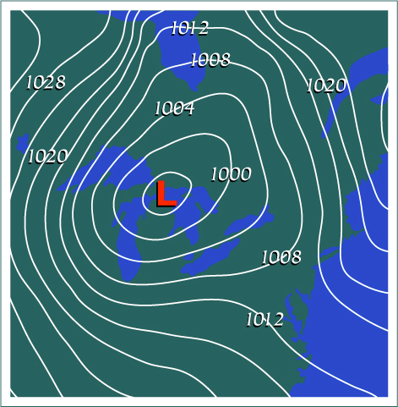
Instructional Objective: After the completion of a jig-saw activity identifying the different characteristics and symbols on a weather map, the students will be able to present their weather map’s forecast and make predictions for tomorrow’s weather in a region of the United States. The students will complete the task with at least seventy-five percent accuracy. Standard: PS 2.2i Weather describes the conditions of the atmosphere at a given location for a short period of time.
Isobars
Are Lines on a Map that Represent Areas of Equal Air Pressure.
These lines help to show areas of High and Low Pressure Systems as well as providing information about wind speed.
The closer the lines are together, the larger the pressure difference is over an area which means faster, stronger winds.
The further apart the lines are, means less of a pressure difference over an area creating gentler winds.

Slide 7
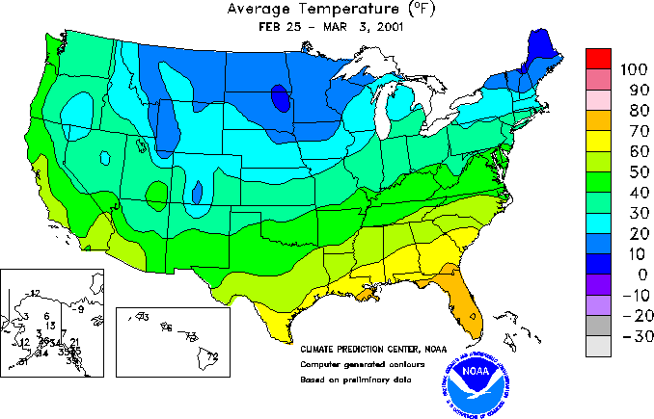
Instructional Objective: After the completion of a jig-saw activity identifying the different characteristics and symbols on a weather map, the students will be able to present their weather map’s forecast and make predictions for tomorrow’s weather in a region of the United States. The students will complete the task with at least seventy-five percent accuracy. Standard: PS 2.2i Weather describes the conditions of the atmosphere at a given location for a short period of time.
Isotherms
Connect Areas of Equal Temperature on a Weather Map.

Slide 8
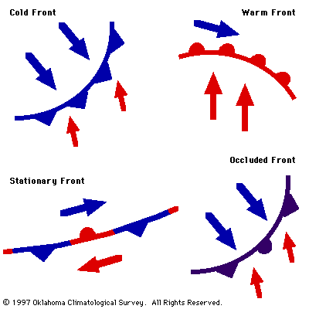
Instructional Objective: After the completion of a jig-saw activity identifying the different characteristics and symbols on a weather map, the students will be able to present their weather map’s forecast and make predictions for tomorrow’s weather in a region of the United States. The students will complete the task with at least seventy-five percent accuracy. Standard: PS 2.2i Weather describes the conditions of the atmosphere at a given location for a short period of time.
Major Factors in Predicting Weather:
The Movement of Air Masses, Fronts and Pressure Systems!

Slide 9
Instructional Objective: After the completion of a jig-saw activity identifying the different characteristics and symbols on a weather map, the students will be able to present their weather map’s forecast and make predictions for tomorrow’s weather in a region of the United States. The students will complete the task with at least seventy-five percent accuracy. Standard: PS 2.2i Weather describes the conditions of the atmosphere at a given location for a short period of time.
Now…
Please Break up into FOUR EQUAL Groups. Each group will be seated at a different table. These groups will all be given a weather map.
Each table will draw their weather map element on the map. Then the group leader (Who I Will Chose) will move to the next group on their right and share this information. This will continue until everyone has a complete weather map.
Then each group will be assigned a region of the US to give the weather forecast of for today and tomorrow.

Slide 10
Instructional Objective: After the completion of a jig-saw activity identifying the different characteristics and symbols on a weather map, the students will be able to present their weather map’s forecast and make predictions for tomorrow’s weather in a region of the United States. The students will complete the task with at least seventy-five percent accuracy. Standard: PS 2.2i Weather describes the conditions of the atmosphere at a given location for a short period of time.
Homework:
Watch the weather forecast for tonight and write a one paragraph summary of what the weather forecast predicts.

