Slide 1




Learning Objective: After the completion of a Word Splash activity on air masses, the students will demonstrate their understanding of the content by labeling and explaining the different air masses that affect weather in the United States, by labeling and explaining at least four out of six air masses correctly.
Standards: PS 2.2l Air masses form when air remains nearly stationary over a large section of Earth’s surface and takes on the conditions of temperature and humidity from that location. Weather conditions at a location are determined primarily by temperature, humidity, and pressure of air masses over that location.
Aim: What are the six air masses that affect weather in the United States?
Do Now: Choose two of the following words and write two sentences containing each of these words:
Air Masses
Source Region
High Pressure Systems
Low Weather Systems
Cyclone
Anti-Cyclone
Barometer

Slide 2


Learning Objective: After the completion of a Word Splash activity on air masses, the students will demonstrate their understanding of the content by labeling and explaining the different air masses that affect weather in the United States, by labeling and explaining at least four out of six air masses correctly.
Standards: PS 2.2l Air masses form when air remains nearly stationary over a large section of Earth’s surface and takes on the conditions of temperature and humidity from that location. Weather conditions at a location are determined primarily by temperature, humidity, and pressure of air masses over that location.
Now that we have our sentences…
WHO WANTS TO SHARE?
Write your sentence below:
Now: Organize ALL the vocabulary words in an order that you think they relate to each other.

Slide 3
Learning Objective: After the completion of a Word Splash activity on air masses, the students will demonstrate their understanding of the content by labeling and explaining the different air masses that affect weather in the United States, by labeling and explaining at least four out of six air masses correctly.
Standards: PS 2.2l Air masses form when air remains nearly stationary over a large section of Earth’s surface and takes on the conditions of temperature and humidity from that location. Weather conditions at a location are determined primarily by temperature, humidity, and pressure of air masses over that location.
Our next step is to find out all about AIR MASSES!
We are going to read a passage together.
The vocabulary words are bolded.
PAY CLOSE ATTENTION!

Slide 4
Learning Objective: After the completion of a Word Splash activity on air masses, the students will demonstrate their understanding of the content by labeling and explaining the different air masses that affect weather in the United States, by labeling and explaining at least four out of six air masses correctly.
Standards: PS 2.2l Air masses form when air remains nearly stationary over a large section of Earth’s surface and takes on the conditions of temperature and humidity from that location. Weather conditions at a location are determined primarily by temperature, humidity, and pressure of air masses over that location.
NOW…Please complete TWO more sentences using any two vocabulary words you choose.
Air Masses
Source Region
High Pressure Systems
Low Weather Systems
Cyclone
Anti-Cyclone
Barometer
Who would like to share their new sentences:

Slide 5
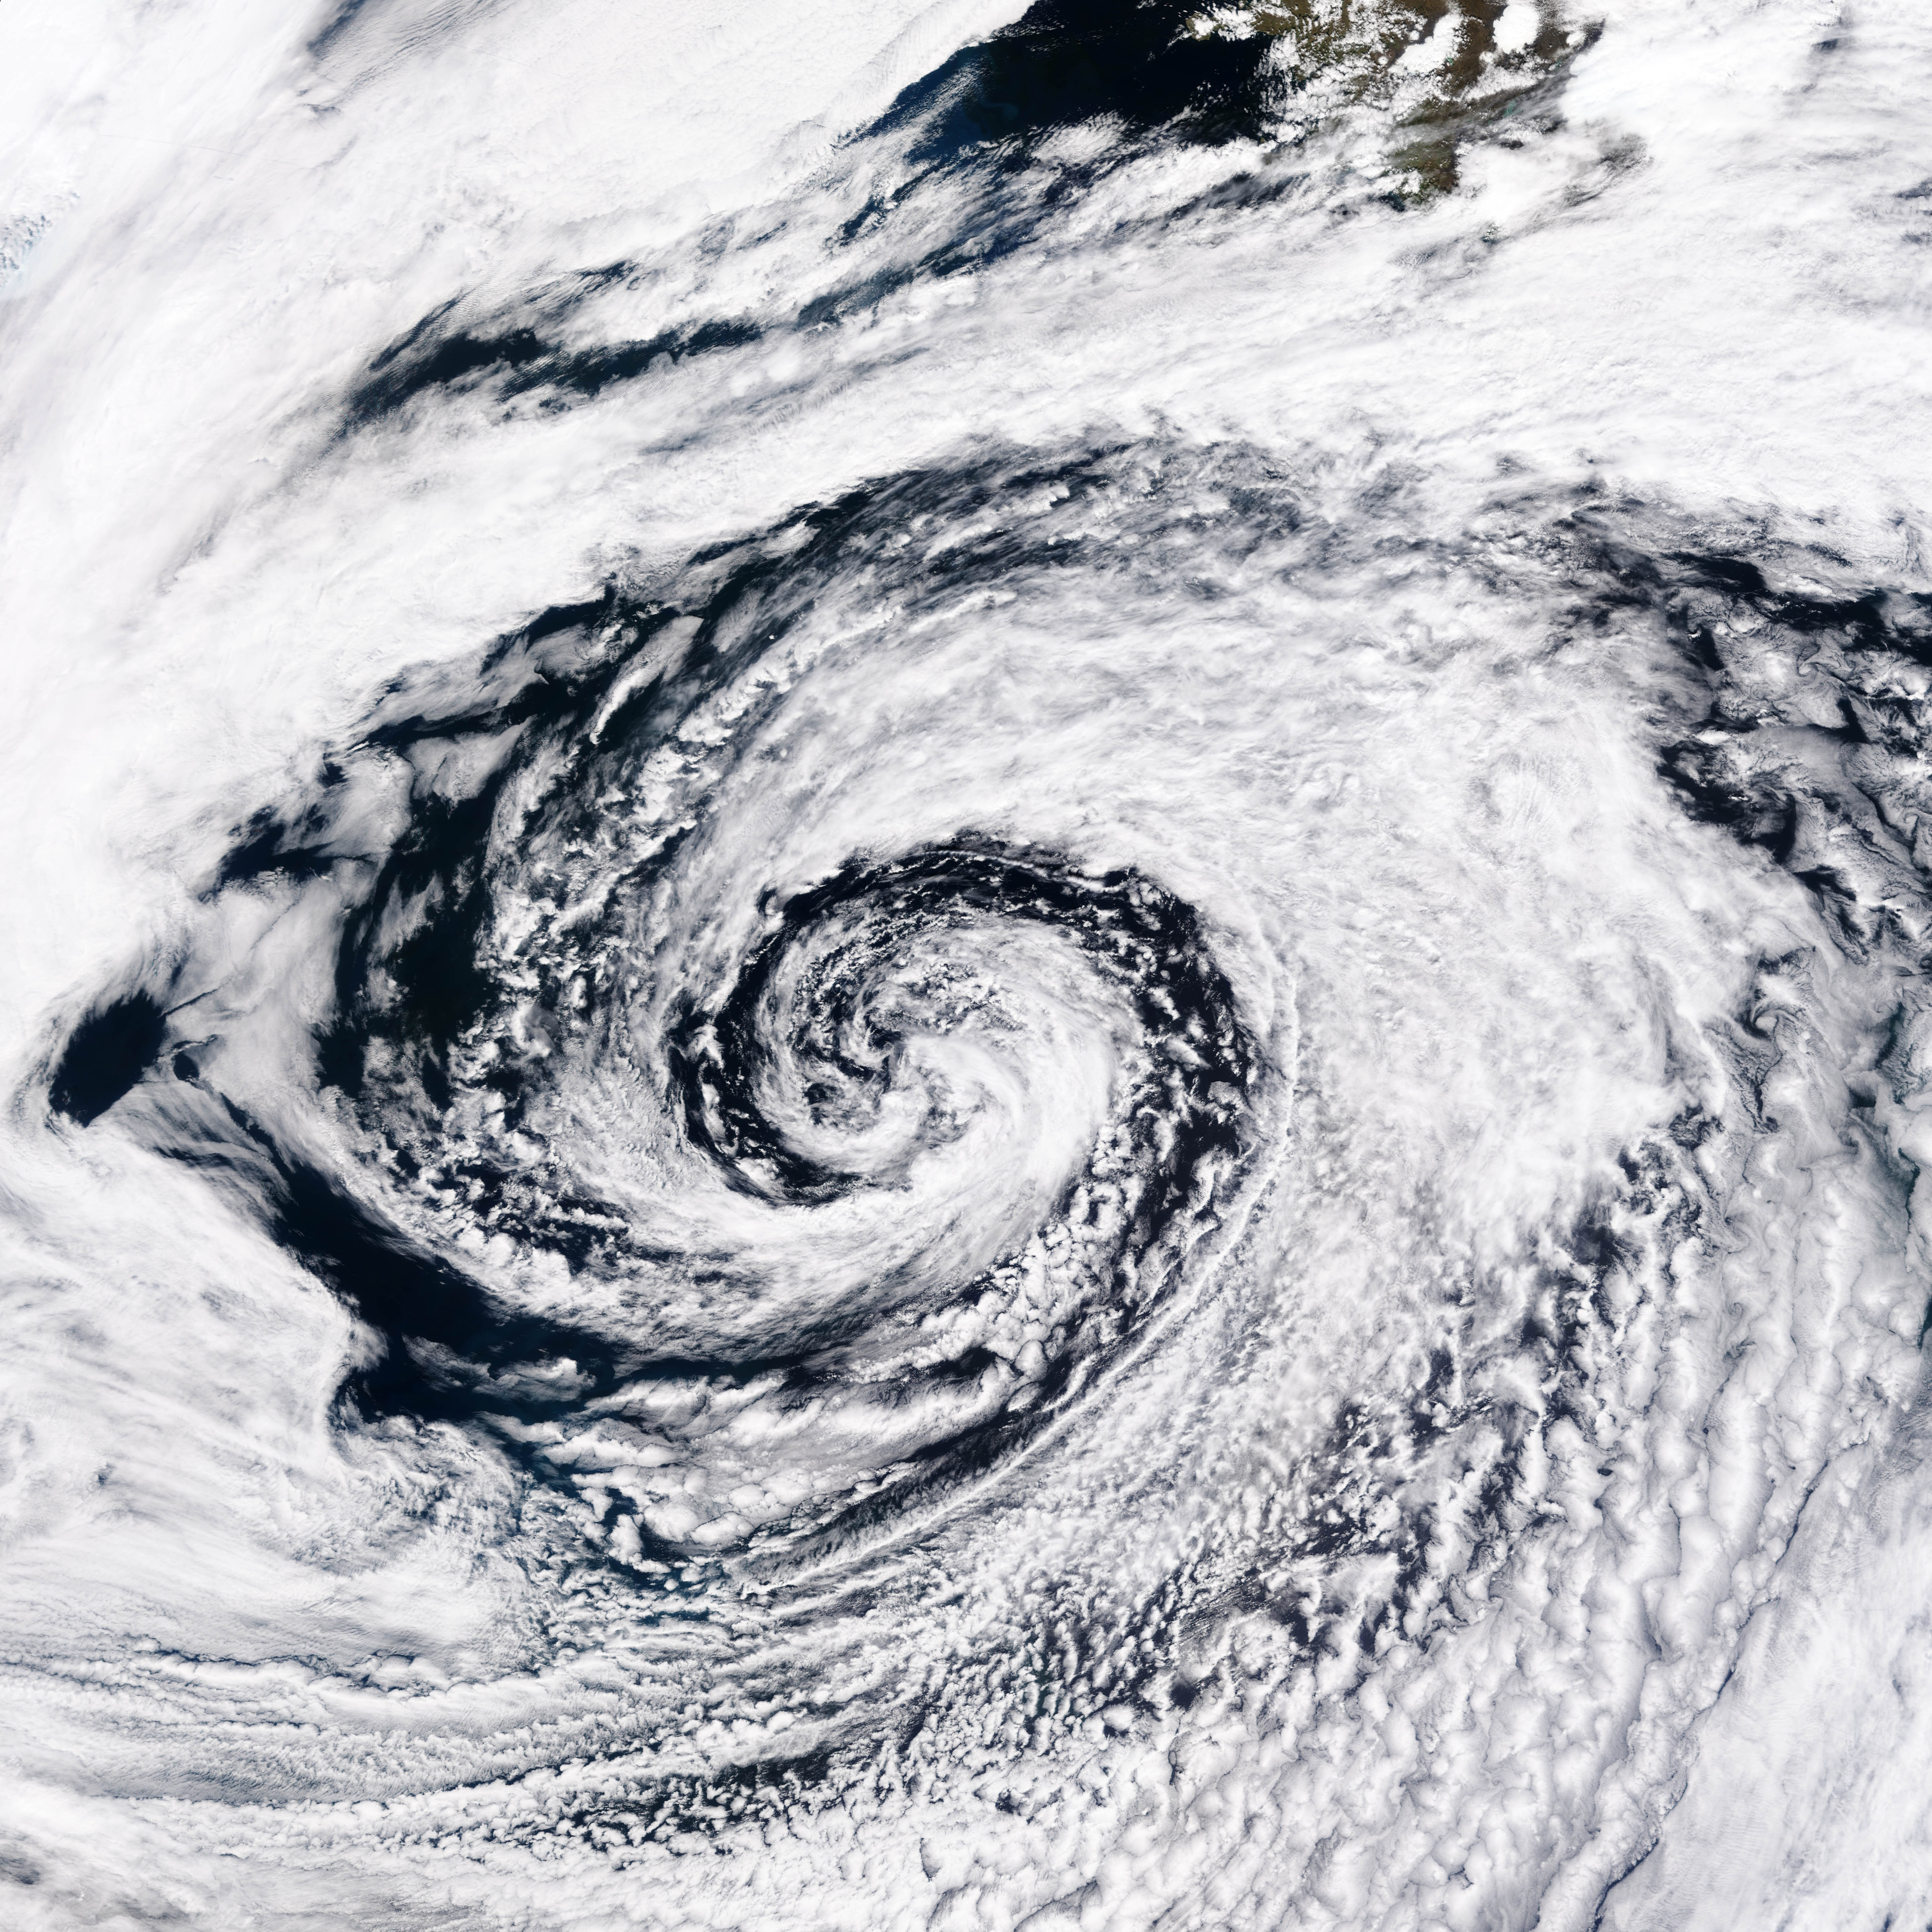
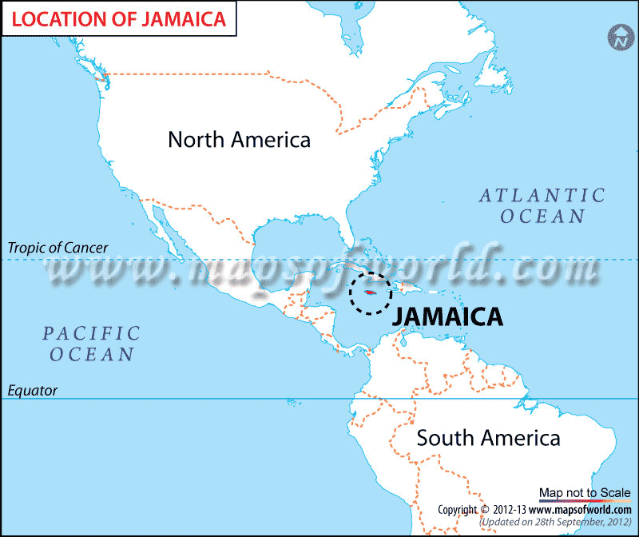
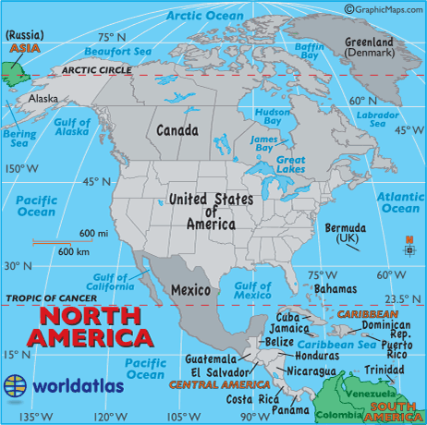
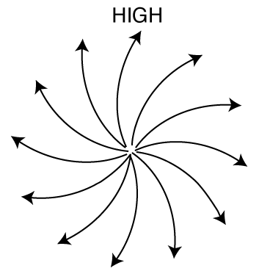
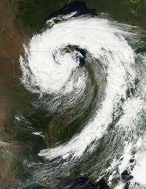
Learning Objective: After the completion of a Word Splash activity on air masses, the students will demonstrate their understanding of the content by labeling and explaining the different air masses that affect weather in the United States, by labeling and explaining at least four out of six air masses correctly.
Standards: PS 2.2l Air masses form when air remains nearly stationary over a large section of Earth’s surface and takes on the conditions of temperature and humidity from that location. Weather conditions at a location are determined primarily by temperature, humidity, and pressure of air masses over that location.
Let’s do it together: Let’s try and name the different types of air masses affecting or forming in certain regions.
What type of air mass will affect New York if its from Canada?
What air mass would form by Jamaica?
Warm/Moist
Cold/Dry
A high pressure system is over London. What type of weather will they have?
A cyclone is associated with which type of pressure system?
Nice Weather
Low Pressure System

Slide 6
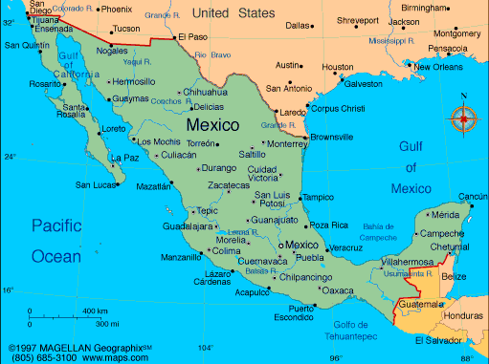
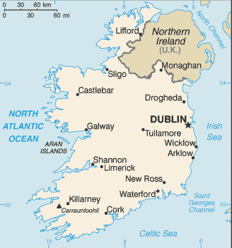
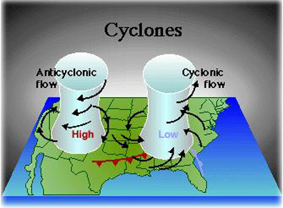
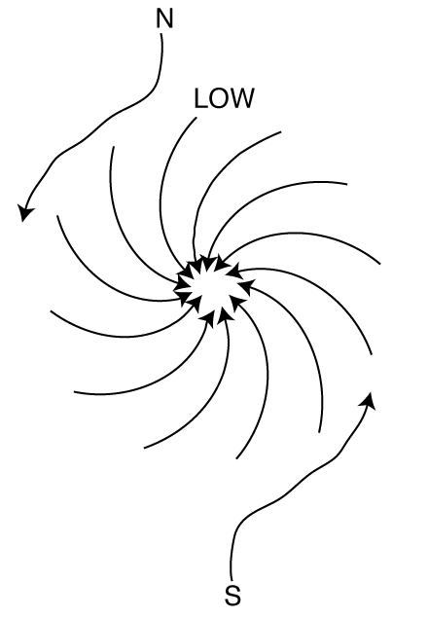
Learning Objective: After the completion of a Word Splash activity on air masses, the students will demonstrate their understanding of the content by labeling and explaining the different air masses that affect weather in the United States, by labeling and explaining at least four out of six air masses correctly.
Standards: PS 2.2l Air masses form when air remains nearly stationary over a large section of Earth’s surface and takes on the conditions of temperature and humidity from that location. Weather conditions at a location are determined primarily by temperature, humidity, and pressure of air masses over that location.
Try it By Yourself:
What air mass would form over Mexico?
If a cool/moist air mass was affecting Ireland, where could it have come from?
Warm/Dry
North Atlantic Ocean
An anti-cyclone moves in which direction?
A low pressure system is associated with which type of weather?
Counter-clockwise
Stormy weather

Slide 7

Learning Objective: After the completion of a Word Splash activity on air masses, the students will demonstrate their understanding of the content by labeling and explaining the different air masses that affect weather in the United States, by labeling and explaining at least four out of six air masses correctly.
Standards: PS 2.2l Air masses form when air remains nearly stationary over a large section of Earth’s surface and takes on the conditions of temperature and humidity from that location. Weather conditions at a location are determined primarily by temperature, humidity, and pressure of air masses over that location.
Homework:
Complete the worksheet on air masses.
Label and Explain each air mass that affects the United States.

