Slide 1
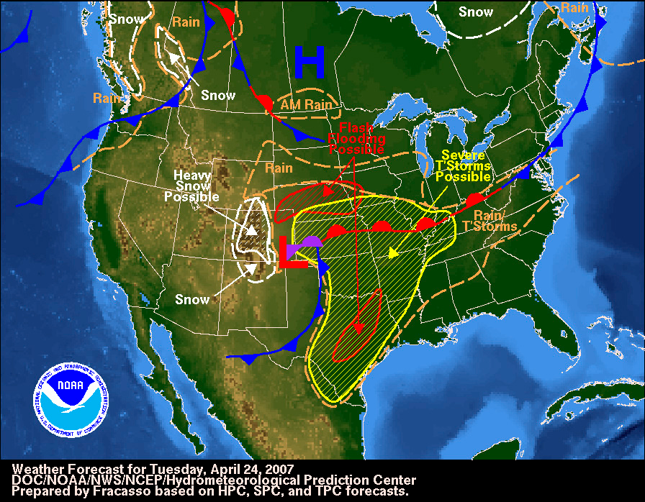

Instructional Objective: After the completion of a class discussion on weather fronts, the students will be able to identify and label weather fronts on a map by identifying at least three out of fours fronts correctly.
Standards: PS 2.2o Fronts are boundaries between air masses. Precipitation is likely to occur at these boundaries.
Aim: What are the different types of fronts? Can you identify them on a weather map?
Do Now: Take your seats, take out a pencil and notebook. Now get ready…listen to the following clip and then explain it to me.

Slide 2

Instructional Objective: After the completion of a class discussion on weather fronts, the students will be able to identify and label weather fronts on a map by identifying at least three out of fours fronts correctly.
Standards: PS 2.2o Fronts are boundaries between air masses. Precipitation is likely to occur at these boundaries.
We Already Know About Air Masses…
What characteristics does an air mass have if it forms over:
Land?
- Dry
2. Water?
- Moist
3. A region closer to the equator?
- Warm
4. A region closer to the poles?
- Cold

Slide 3
Instructional Objective: After the completion of a class discussion on weather fronts, the students will be able to identify and label weather fronts on a map by identifying at least three out of fours fronts correctly.
Standards: PS 2.2o Fronts are boundaries between air masses. Precipitation is likely to occur at these boundaries.
Today, we are going to learn about fronts...
Fronts are formed from air masses.
Air masses are continuously moving across the globe, however, when the different air masses meet very little mixing occurs.
Therefore, the air masses have their distinct differences.
This boundary between the two air masses is called a FRONT.

Slide 4
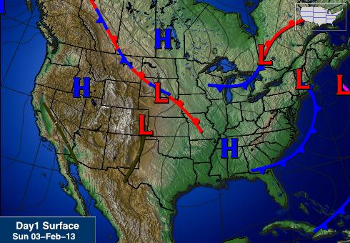
Fronts are visible on a weather map.

Slide 5
Instructional Objective: After the completion of a class discussion on weather fronts, the students will be able to identify and label weather fronts on a map by identifying at least three out of fours fronts correctly.
Standards: PS 2.2o Fronts are boundaries between air masses. Precipitation is likely to occur at these boundaries.
There are FOUR different types of fronts…
Can you name them? Any ideas?
Cold Front
Warm Front
Occluded Front
Stationary Front

Slide 6
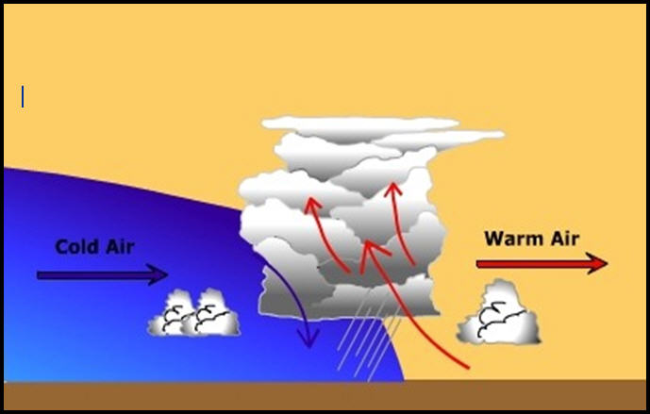
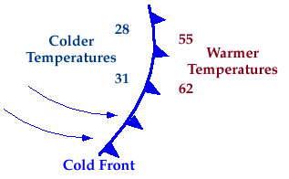
Instructional Objective: After the completion of a class discussion on weather fronts, the students will be able to identify and label weather fronts on a map by identifying at least three out of fours fronts correctly.
Standards: PS 2.2o Fronts are boundaries between air masses. Precipitation is likely to occur at these boundaries.
Cold Front:
Occurs when cold air advances toward warmer air. Since cold air sinks and warm air rises, the cold air acts like a plow and rapidly lifts the warm air. As warm air rises, it cools and condenses forming clouds. This can create large storm systems that may produce thunderstorms, tornadoes or snow.

Slide 7
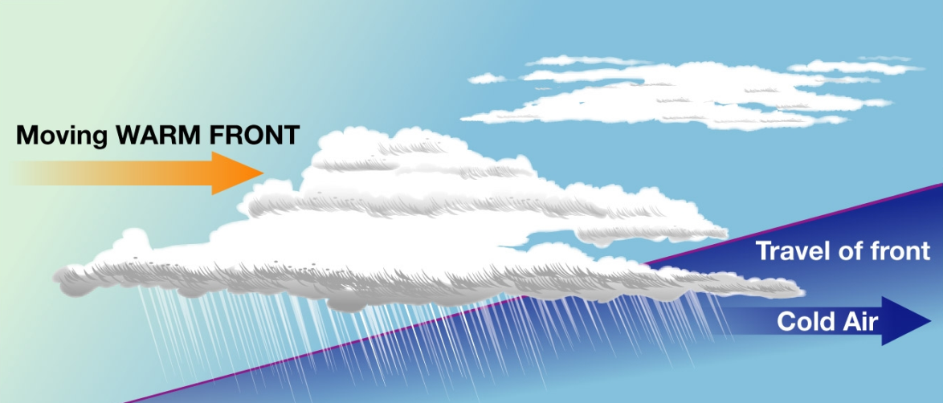
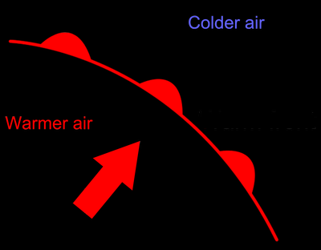
Instructional Objective: After the completion of a class discussion on weather fronts, the students will be able to identify and label weather fronts on a map by identifying at least three out of fours fronts correctly.
Standards: PS 2.2o Fronts are boundaries between air masses. Precipitation is likely to occur at these boundaries.
Warm Front:
Occurs when lighter, warmer air advances over heavier, colder air. This creates lowered clouds and widespread precipitation.

Slide 8
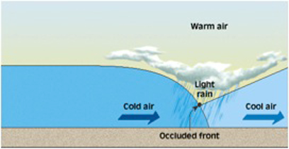

Instructional Objective: After the completion of a class discussion on weather fronts, the students will be able to identify and label weather fronts on a map by identifying at least three out of fours fronts correctly.
Standards: PS 2.2o Fronts are boundaries between air masses. Precipitation is likely to occur at these boundaries.
Occluded Front:
Occurs when there are three air masses present in an area, cold, cool and warm. Normally, a cold air mass overtakes a slower warm air mass, lifting it up. The warm air mass is then “trapped” above a cold air mass and a cooler air mass creating large scale condensation and precipitation.

Slide 9
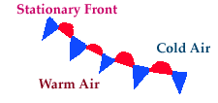
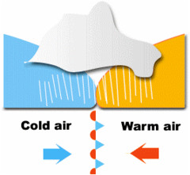
Instructional Objective: After the completion of a class discussion on weather fronts, the students will be able to identify and label weather fronts on a map by identifying at least three out of fours fronts correctly.
Standards: PS 2.2o Fronts are boundaries between air masses. Precipitation is likely to occur at these boundaries.
Stationary Front:
Occurs when a cold front and a warm front stop advancing and remain in the same place for several days. The boundary slowly takes on the characteristics of a warm front as the cold air sinks. This front produces light wind and precipitation.

Slide 10
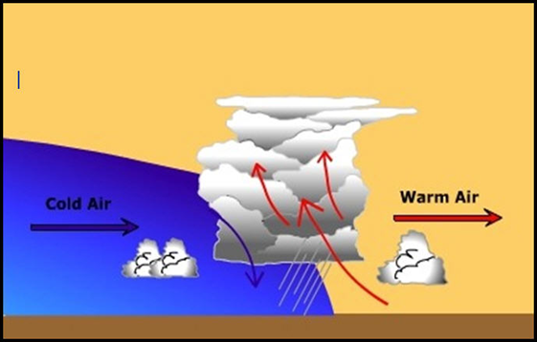
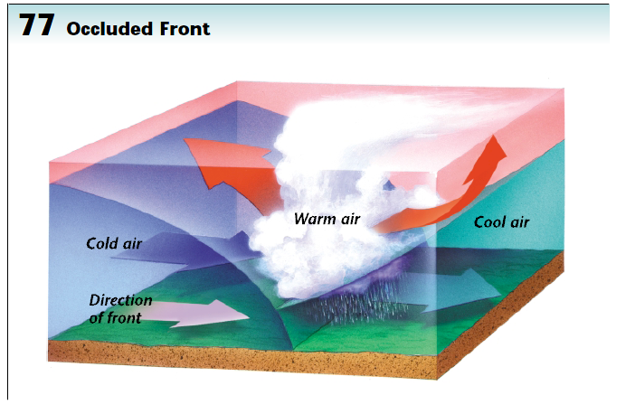
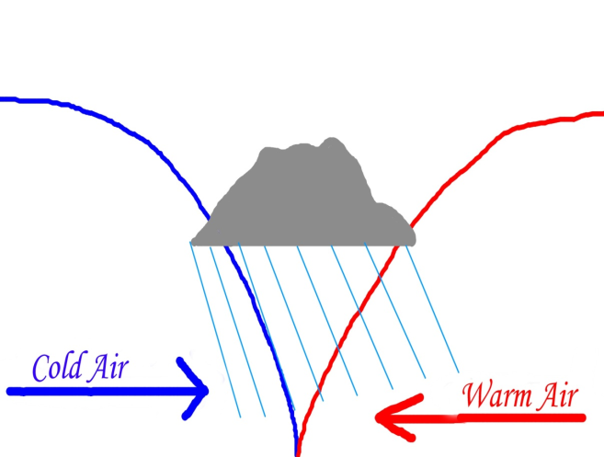
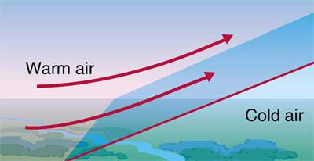
Instructional Objective: After the completion of a class discussion on weather fronts, the students will be able to identify and label weather fronts on a map by identifying at least three out of fours fronts correctly.
Standards: PS 2.2o Fronts are boundaries between air masses. Precipitation is likely to occur at these boundaries.
Let’s try to identify fronts together!
Cold Front
Occluded Front
Stationary Front
Warm Front

Slide 11
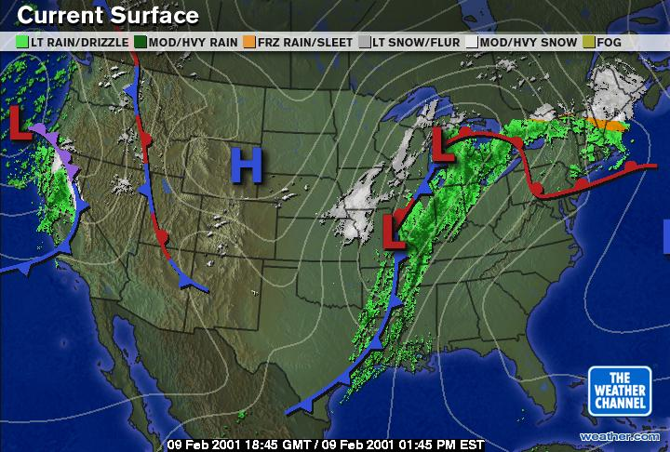
Instructional Objective: After the completion of a class discussion on weather fronts, the students will be able to identify and label weather fronts on a map by identifying at least three out of fours fronts correctly.
Standards: PS 2.2o Fronts are boundaries between air masses. Precipitation is likely to occur at these boundaries.
Now on a map!

Slide 12

Instructional Objective: After the completion of a class discussion on weather fronts, the students will be able to identify and label weather fronts on a map by identifying at least three out of fours fronts correctly.
Standards: PS 2.2o Fronts are boundaries between air masses. Precipitation is likely to occur at these boundaries.
Now it’s your turn…
Complete the following worksheet by drawing the correct weather fronts on the map. You will need a Red, Blue and Purple crayon! Remember to share.

Slide 13

Instructional Objective: After the completion of a class discussion on weather fronts, the students will be able to identify and label weather fronts on a map by identifying at least three out of fours fronts correctly.
Standards: PS 2.2o Fronts are boundaries between air masses. Precipitation is likely to occur at these boundaries.
Homework:
For homework, complete the worksheet on Fronts.

